Slide 1
CSE101-Lec#27
Nested Structure
Union

Slide 2
Outline
Nested Structure
Union

Slide 3
Nested Structure
Nested structures are structures as member of another structure.
We can also take objects of one structure as member in another structure.
Thus, a structure within a structure can be used to create complex data application.
Dot operator is used twice because we are accessing first structure through the object of second structure.

Slide 4
Nested Structure
Two ways of declaring structure within structure or Nested structure:
Declare two separate structures
Embedded structures

Slide 5
Example-1-Declare two separate structures(standalone structures)
struct Date
{
int dd;
int mm;
int yy;
};
struct Student
{
char name[20];
int rollno;
int marks;
struct Date dob;
};
Here structure Student is nesting structure and structure date is nested structure

Slide 6
Program example-1 Nested structure-Declare two separate structures(standalone structures)
#include<stdio.h>
struct Address
{
char Housename[25];
char City[25];
char Streetname[25];
};
struct Employee
{
int Id;
char Name[25];
float Salary;
struct Address Add;
};
int main()
{
struct Employee E;
printf("\n\tEnter Employee Id : ");
scanf("%d",&E.Id);
printf("\n\tEnter Employee Name : ");
scanf("%s",E.Name);
printf("\n\tEnter Employee Salary : ");
scanf("%f",&E.Salary);
printf("\n\tEnter Employee House Name : ");
scanf("%s",E.Add.Housename);
printf("\n\tEnter Employee City : ");
scanf("%s",E.Add.City);
printf("\n\tEnter Employee street name : ");
scanf("%s",E.Add.Streetname);
printf("\nDetails of Employees");
printf("\n\tEmployee Id : %d",E.Id);
printf("\n\tEmployee Name : %s",E.Name);
printf("\n\tEmployee Salary : %f",E.Salary);
printf("\n\tEmployee House No : %s",E.Add.Housename);
printf("\n\tEmployee City : %s",E.Add.City);
printf("\n\tEmployee street name: %s",E.Add.Streetname);
}

Slide 7
Example-2: embedded structures(Nested structure)
struct Student
{
char name[20];
int rollno;
struct date
{
int dd;
int mm;
int yy;
} dob;
};
Notes:
Structure date is not having independent existence

Slide 8
Program example-2 Nested structure-Embedded structure
#include <stdio.h>
struct Employee
{
char ename[20];
int ssn;
float salary;
struct dob
{
int date;
int month;
int year;
}db1;
}emp = {"Aniket",1000,1000.50,{22,6,1990}};
int main()
{
printf("\nEmployee Name : %s",emp.ename);
printf("\nEmployee SSN : %d",emp.ssn);
printf("\nEmployee Salary : %.2f",emp.salary);
printf("\nEmployee DOB : %d/%d/%d",emp.db1.date,emp.db1.month,emp.db1.year);
return 0;
}

Slide 9
Unions
union
Memory that contains a variety of objects over time
Only contains one data member at a time
Members of a union share space
Conserves storage
Only the last data member defined can be accessed
union definitions
Same as struct
union Number {
int x;
float y;
};
union Number value;

Slide 10
Union
Union is similar as structure. The major distinction between them is in terms of storage.
In structure each member has its own storage location whereas all the members of union uses the same location.
The union may contain many members of different data type but it can handle only one member at a time union can be declared using the keyword union.

Slide 11

Example
A class is a very good example of structure and union in this example students are sitting in contiguous memory allocation as they are treated as a structure individually. And if we are taking the place of teacher then in a class only one teacher can teach. After leaving the first teacher then another teacher can enter.

Slide 12
Union Declaration
union item
{
int m;
float x;
char c;
}code;
This declare a variable code of type union item

Slide 13
Initializing and accessing union members
#include <stdio.h>
#include <string.h>
union Data {
int i;
float f;
char str[20];
};
int main( )
{
union Data data;
data.i = 10;
data.f = 220.5;
strcpy( data.str, "C Programming");
printf( "data.i : %d\n", data.i);
printf( "data.f : %f\n", data.f);
printf( "data.str : %s\n", data.str);
return 0;
}

Slide 14
#include <stdio.h>
union job{
char name[32];
float salary;
int worker_no;
}u;
main()
{
printf("Enter name:\n");
scanf("%s",&u.name);
printf("Enter salary: \n");
scanf("%f",&u.salary);
printf("Displaying\nName :%s\n",u.name);
printf("Salary: %.1f",u.salary);
}
Program using union.

Slide 15
WAP to read and display one record using union
#include<stdio.h>
union employee
{
char name[30];
int id;
float salary;
}u;
int main()
{
//union employee u;
printf("\n Enter name:");
gets(u.name);//Initialization
printf("\n Entered name is:%s",u.name);//Accessing
printf("\n Enter id:");
scanf("%d",&u.id);//Initialization
printf("\n Entered id is:%d",u.id);//Accessing
printf("\n Enter salary:");
scanf("%f",&u.salary);//Initialization
printf("\n Entered salary is:%.2f",u.salary);//Accessing
return 0;
}

Slide 16
WAP to read and display n number of records using Array of Unions
#include<stdio.h>
union employee
{
char name[30];
int id;
float salary;
}u[100];
int main()
{
//union employee u[100];
int n,i;
printf("\n Enter value of n:");
scanf("%d",&n);
fflush(stdin);
for(i=0;i<n;i++)
{
printf("\n Enter name:");
fflush(stdin);
gets(u[i].name);
printf("\n Entered name is:%s",u[i].name);
printf("\n Enter id:");
fflush(stdin);
scanf("%d",&u[i].id);
printf("\n Entered id is:%d",u[i].id);
printf("\n Enter salary:");
fflush(stdin);
scanf("%f",&u[i].salary);
printf("\n Entered salary is:%.2f",u[i].salary);
}
return 0;
}

Slide 17
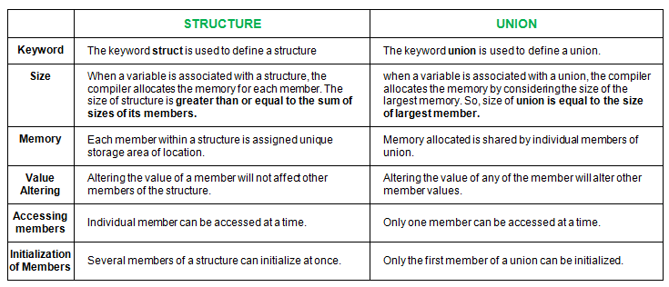
Difference between structure and union

Slide 18
Similarities between structure and union
Both are user-defined data types used to store data of different types as a single unit.
Their members can be objects of any type, including other structures and unions or arrays. A member can also consist of a bit field.
Both structures and unions support only assignment = and sizeof operators. The two structures or unions in the assignment must have the same members and member types.
A structure or a union can be passed by value to functions and returned by value by functions. The argument must have the same type as the function parameter. A structure or union is passed by value just like a scalar variable as a corresponding parameter.
‘.’ operator is used for accessing members.

Slide 19
What will be the size of the following structure?
struct demo
{
int a;
char b;
float c;
}
12
8
10
9

Slide 20
What is the output of this program?
#include <stdio.h>
int main()
{ struct simp
{ int i = 6;
char city[] = "chennai";
};
struct simp s1;
printf("%d",s1.city);
printf("%d", s1.i);
return 0;
}
A. chennai 6 B. Nothing will be displayed C. Runtime Error D. Compilation Error

